Slide 1
EDA CASE STUDY
BY ARAVIND GHOSH A R

Slide 2
PROBLEM STATEMENT
When the company receives a loan application, the company has to decide for loan approval based on the applicant’s profile. Two types of risks are associated with the bank’s decision:
If the applicant is likely to repay the loan, then not approving the loan results in a loss of business to the company
If the applicant is not likely to repay the loan, i.e. he/she is likely to default, then approving the loan may lead to a financial loss for the company

Slide 3
The data given below contains the information about the loan application at the time of applying for the loan. It contains two types of scenarios:
Had late payment more than X days on at least one of the first Y instalments of the loan in our sample.
All other cases when the payment is paid on time.

Slide 4
When a client applies for a loan, there are four types of decisions that could be taken by the client/company :
Approved: The Company has approved loan Application.
Cancelled: The client cancelled the application her/his mind about the loan or in some cases due to a higher risk of the client he received worse pricing which he did not want.
Refused: The company had rejected the loan (because the client does not meet their requirements etc.).
Unused offer: Loan has been cancelled by the client but on different stages of the process.

Slide 5
ANAYLSIS APPROACH
The data was inspected thoroughly and filtering & cleaning process was done.
Outliers were detected for a few numerical variables to gain better insights.
And finally 2 separate data frames are created for understanding the difference between the people with payment difficulties and without payment difficulties.

Slide 6
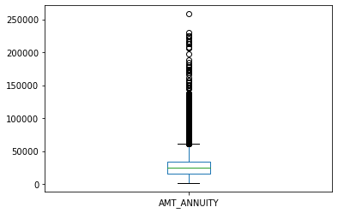
FINDING OUTLIERS OF A CONTINOUS VARIABLES
1.AMT_ANNUITY

Slide 7
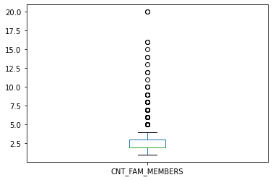
2. CNT_FAM_MEMBERS

Slide 8
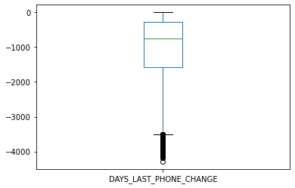
3. DAYS_LAST_PHONE_CHANGE

Slide 9
HANDLING THE MISSING VALUES

Slide 10
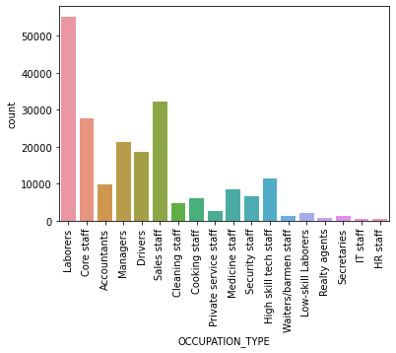
1. OCCUPATION_TYPE
We will leave it as it is ,because it is a categorical column, and will not do any missing value treatment here. Even though it has almost 31% missing values, we cannot replace the values with the mean.

Slide 11
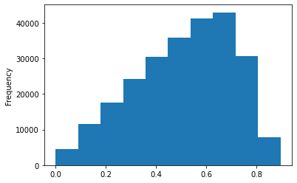
2. EXT_SOURCE_3

Slide 12
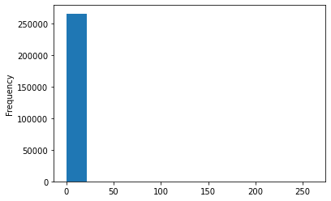
3. AMT_REQ_CREDIT_BUREAU_QRT

Slide 13
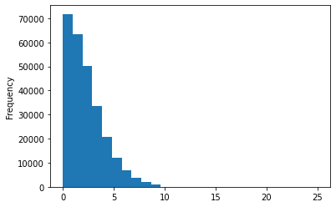
4. AMT_REQ_CREDIT_BUREAU_YEAR

Slide 14
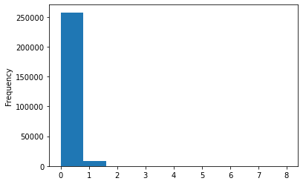
5. AMT_REQ_CREDIT_BUREAU_WEEK

Slide 15
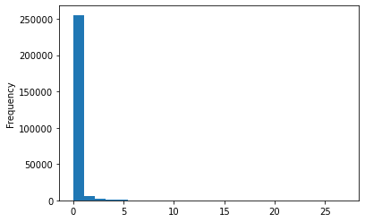
6. AMT_REQ_CREDIT_BUREAU_MON

Slide 16
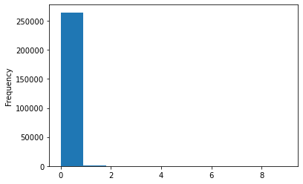
7. AMT_REQ_CREDIT_BUREAU_DAY

Slide 17
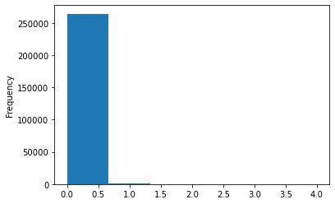
8. AMT_REQ_CREDIT_BUREAU_HOUR

Slide 18
UNIVARIATE ANAYLSIS FOR CATEGORIAL ANAYLSIS

Slide 19
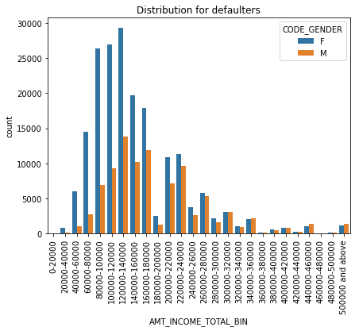
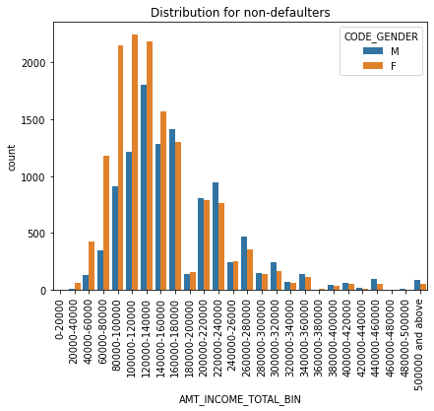
1. AMT_INCOME_TOTAL_BIN
From the above graph, its is clear that:
1.The most defaulters are female.
2.Most of the defaulter's income range is between 80000 and 180000.
3.There are only a few defaulters in the income range of 360000 500000

Slide 20
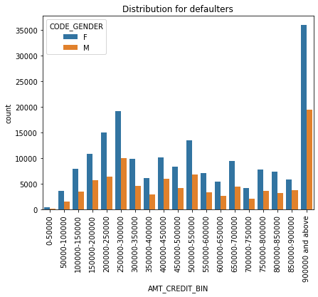
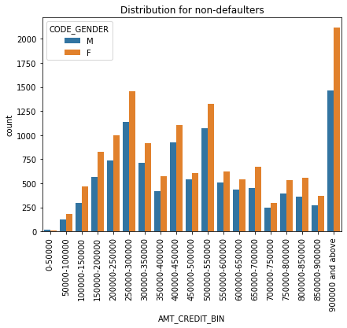
2. AMT_CREDIT_BIN
From the above graph, its is clear that :
1. The highest credit amount lies in the range of 900000 and above

Slide 21
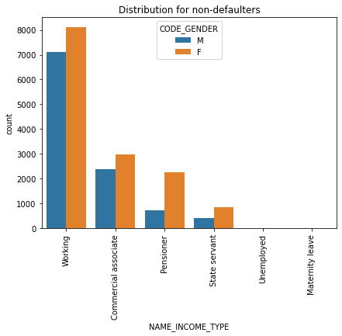
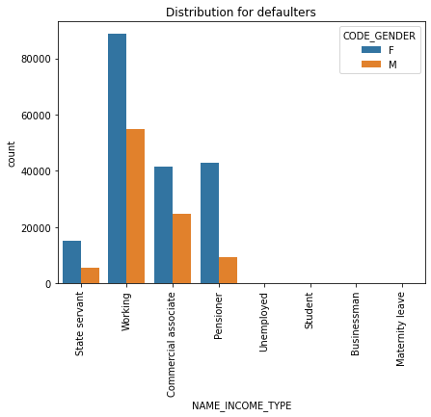
3. NAME_INCOME_TYPE
From the above graph, its is clear that :
1.Majority of the defaulters are under the category 'working' , followed by 'commercial associate' and 'pensioner'.
2.'State Servants' and 'Unemployed' category have very few defaulters.

Slide 22
4. NAME_CONTRACT_TYPE
From the above graph, its is clear that :
1.The type 'cash loans' have the most number of cases.
2.There are only a few cases for the type 'revolving loans'.

Slide 23
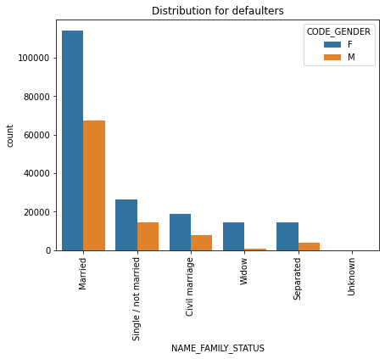
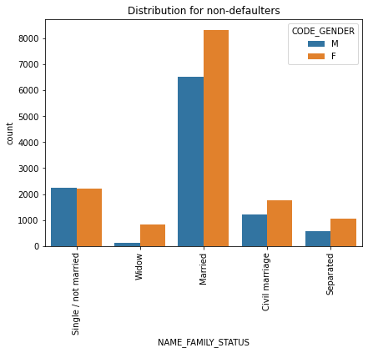
5. NAME_FAMILY_STATUS
From the above graph, its is clear that :
1. 'Married' category has the most number of defaulters.
2. Least defaulters comes from the category 'widowed' and 'seperated'.

Slide 24
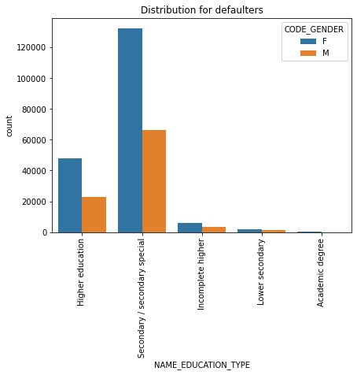
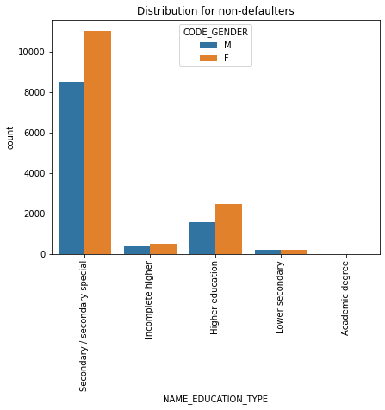
6. NAME_EDUCATION_TYPE
From the above graph, its is clear that :
1. Most defaulters are of the category 'Secondary/secondary special‘.
2. People with academic degree have not become defaulters.

Slide 25
UNIVARIATE ANAYLSIS FOR CONTINUOUS ANAYLSIS

Slide 26
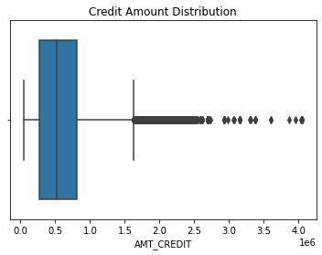
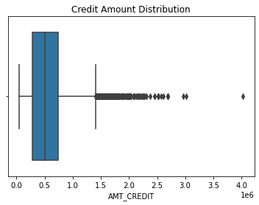
1. AMT_CREDIT
1.We can observe that there are some outliers in the credit amount
2.Most of the credit amount are present between the 50th percentile and 75th percentile for non-defaulters.

Slide 27
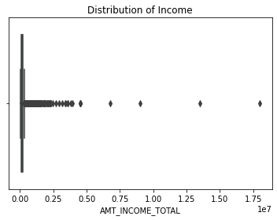
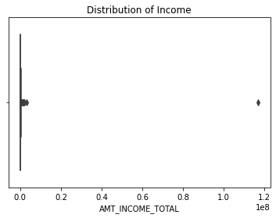
2. AMT_INCOME_TOTAL
Even though there are some outliers in both of the target variables, the income range for both defaulters and non defaulters appear to be very thin

Slide 28
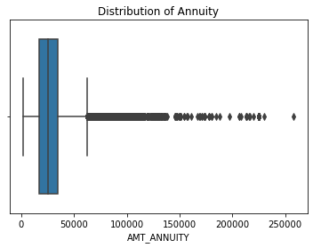
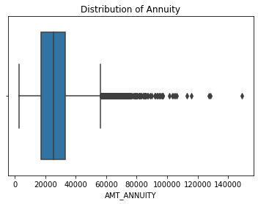
3. AMT_ANNUITY
There are some outliers.
2. The first quartile is bigger than the third quartile for the defaulters.

Slide 29
CORRELATRION FOR TARGET VARIABLES

Slide 30
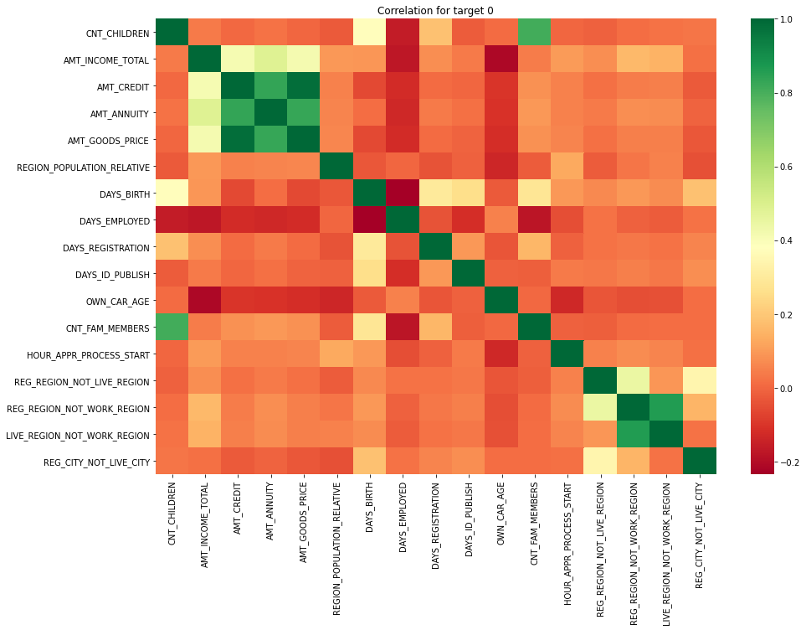
HEATMAP FOR TARGET 0
Observations from the heat map:
Credit amount is inversely proportional to the date of birth, which means Credit amount is higher for younger age and vice-versa.
Income amount is inversely proportional to the number of children.
Credit amount is higher in densely populated area.
The income is higher in densely populated area.

Slide 31
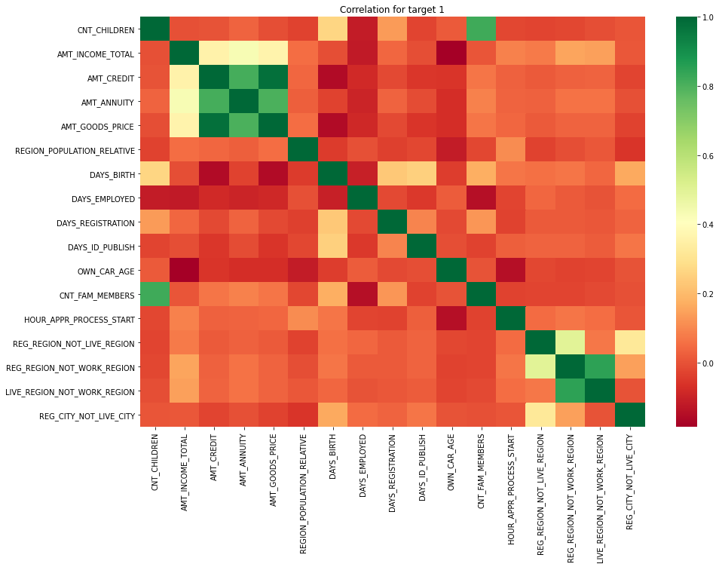
HEATMAP FOR TARGET 1
Heat map of target 1 have also similar observations.
For those clients whose permanent address does not match the contact address are having less children and vice-versa
For those clients whose permanent address does not match work address are having less children and vice-versa

Slide 32
BIVARIATE ANAYLSIS

Slide 33
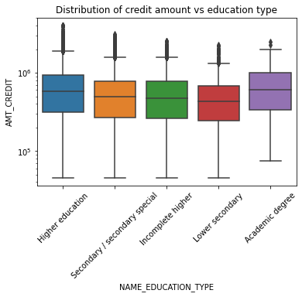
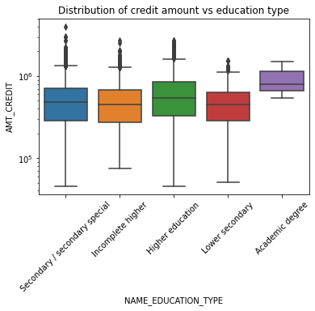
Distribution of Credit amount v/s Education type
We can see that defaulters with academic degree have higher credit amounts compared to others.

Slide 34
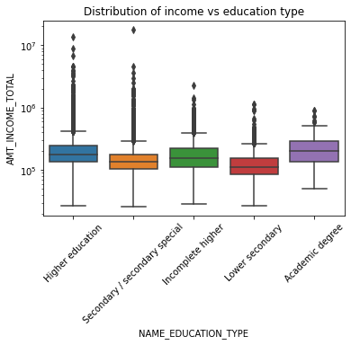
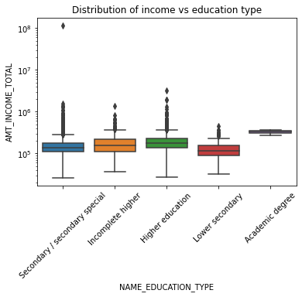
Distribution of Income vs. Education type.
The income of defaulters with an academic degree is higher compared to all other categories.

Slide 35
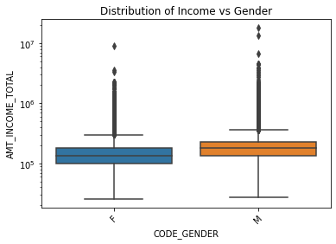
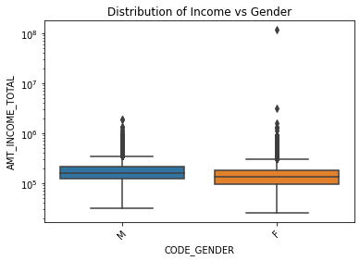
Distribution of Income vs. Gender
We can observe that the income of female defaulters is lesser compared to that of male

Slide 36
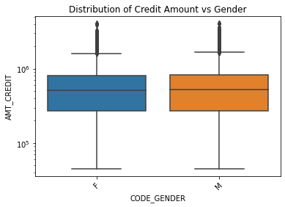
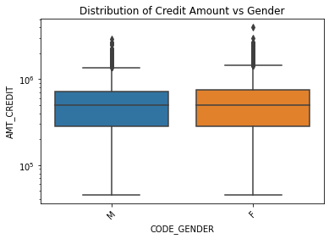
Distribution of Credit Amount vs. Gender
We can observe that the credit amount for female defaulters is slightly higher than that of male.

Slide 37
CONCLUSIONS
Banks should focus more on contract type ‘Student’ ,’Pensioner’ and ‘Businessman’ with housing ‘type other than ‘Co-op apartment’ for successful payments.
Banks should avoid people from the category of 'working' as they have the highest defaulting rates.
Banks should focus more on clients from housing type ‘With parents’ as they are having least number of unsuccessful payments.
Banks should focus more on gender 'male' as they are more likely for successful payments.

Slide 38
THANK YOU

